Slide 1

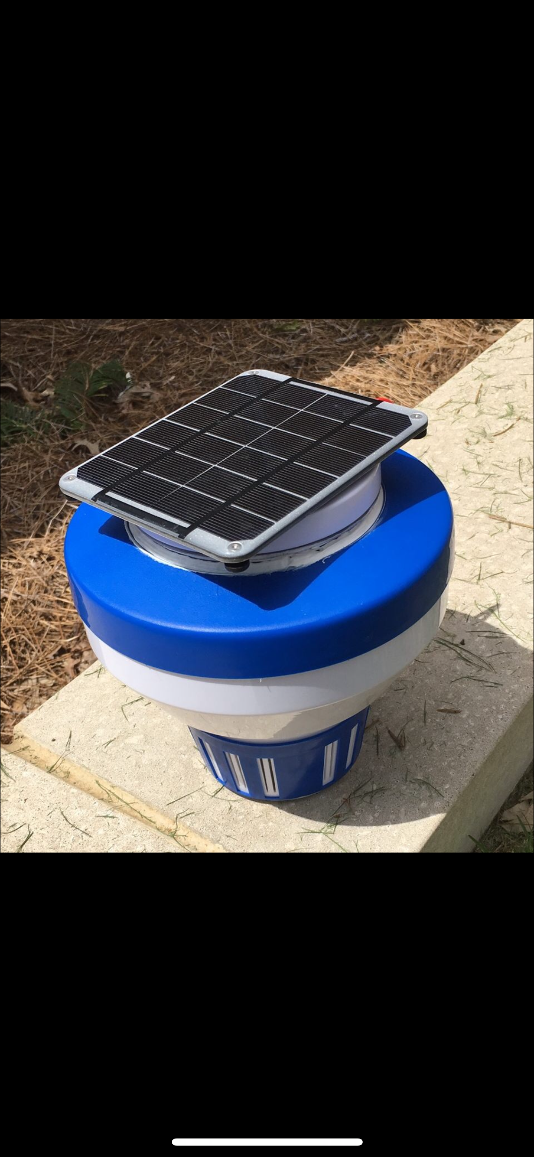
J.U.I.C.Y: Pool Safety Alarm
Marco Zuniga, Cole Graviett, Joe Driscoll, Kaidi Ding, LaShae Timmerman
Matthew Cather, Viraj Patel
Department of Electrical and Computer Engineering, Auburn University, Auburn, Alabama, USA
Abstract
Final Design
Total Costs
The goal of our project was to create a device that can prevent drowning tragedies from occurring. Our device weigh roughly 16 lbs., but can be configured to meet other standards. By placing this device in your private pool, any handheld device synchronized with the pool alarm will receive an alert indicating when a child has fallen into the pool.
(1) Solar Panel: $29.00
(1) DC/Lithium-poly Charger: $17.50
(1) Lithium-poly Battery: $14.95
(1) Powerboost 500: $9.95
(1) Accelerometer: $16.30
(1) Raspberry Pi: $54.99
(1) Chlorine Dispenser: $9.00
Chlorine Dispenser Modifications: $35.00
Shipping costs: $19.12
Total Cost: $205.81
Pool Safety Standards
Certain US states require pool alarms
Tennessee’s Katie Beth Law
Requires device to emit alarm of minimum 50dB
Requires device to detect disturbance caused by 15lb object
Florida has strict building codes concerning residential pools
ASTM F2208-08 Standard Specification for Pool Alarms
The device should emit 85dB at a range of 10ft
No known laws for devices communicating via push notifications
UL Standard for General-Purpose Signaling Devices and Systems and Consumer Product Safety Commission both have published guidelines
References
Testing Procedure
[1] “Drowning." Centers for Disease Control and Prevention. 15 September 2017.
https://www.cdc.gov/healthcommunication/toolstemplates/entertainmented/tips/Drowning.html
[2] “Unintentional Drowning: Get the Facts." Centers for Disease Control and
Prevention. 28 April 2016. https://www.cdc.gov/homeandrecreationalsafety/water-safety/waterinjuries-
factsheet.html
[3] “Risk of Pet Drowning on the Rise!" petplace. 10 December 2014.
https://www.petplace.com/article/dogs/pet-health/risk-of-pet-drowning-on-the-rise/
[4] “A beginner's guide to accelerometers" Dimension Engineering. Date Unknown.
Step 1: Take J.U.I.C.Y to an available pool.
Step 2: Run the python program and store output.
Step 3: Run multiple tests by throwing an object with weight similar to an average toddler into the pool (i.e. 2 gallon jugs filled with water).
Step 4: Adjust thresholds in detection algorithm based on data from experiments.
Disposition
We, all members of the pool safety team, have all agreed to donate our widget
to Auburn University for the purpose of inspiring a new age of engineering.

